Slide 1
LR Structures: algebraic constructions and large vertex-stabilizers (with Primoz Potocnik)
SYGN July, 2014, Rogla

Slide 2
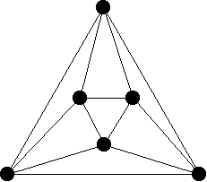
A tetravalent graph is a graph in which every vertex has valence (degree) 4.

Slide 3
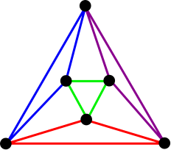
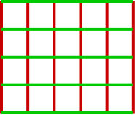
A cycle decomposition is a partition of the edges of the graph into cycles

Slide 4
For any cycle decomposition
its partial line graph

Slide 5
For an LR structure, we first need a cycle decomposition
which is bipartite.

Slide 6
Letting A⁺ be the group of symmetries which preserve edge color,
we need A⁺ to be transitive on vertices.

Slide 7
Moreover, A⁺ must have symmetries which are swappers
a
d
v
b
c
Green swapper fixes b, v, d, interchanges a,c
Red swapper fixes a, v, c, interchanges b,d

Slide 8
If we have an LR structure,
then its partial line graph:
Is bipartite, transitive on vertices of each color
and transitive on edges

Slide 9
There are two ways that an LR structure can be undesirable.
a
d
v
b
c
An alternating 4-cycle => toroidal
(we say it is not ‘smooth’)
(a b)(c d) or (a b c d) = color-reversing symmetry => the structure is self-dual
An LR structure exhibiting neither of these abberations is suitable.

Slide 10
If an LR structure is suitable, then its partial line graph is semisymmetric.
And every tetravalent semisymmetric graph of girth 4 is the partial line graph of some suitable LR structure.

Slide 11
Algebraic Constructions
Let A be a group generated by some a, b, c, d, and suppose that b = a⁻¹ or a and b each have order 2, and similarly for c, d.

Slide 12
Then define the structure to have one vertex for each g in A. Red edges connect g – ag and g – bg; greens are g – cg and g – dg.
This just a coloring of
Cay(A, {a, b, c, d}

Slide 13
To make it an LR structure, we need f, g in Aut(A) such that f fixes a and b while interchanging c and d, and vice versa for g.
Then f and g act as color-preserving symmetries of the structure, and as swappers at Id_{A}. We call them Cayley swappers.

Slide 14
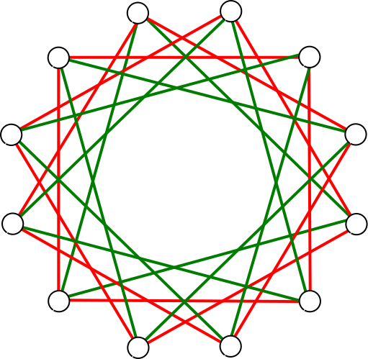
Example: A = Z₁₂, a=3, b = -3 = 9, c = 4, d = -4 = 8.
Then let f=5, g = 7.

Slide 15
Example: A = Z₁₂, a=3, b = -3 = 9, c = 4, d = -4 = 8.
Unfortunately,
12 – 4 -7 -3 -12
is an alternating 4-cycle, and so this structure is not suitable.

Slide 16
If A is any abelian group, the 4-cycle 0 – a – a+c – c – 0 is alternating and so the structure cannot be suitable.

Slide 17
In general, if A is a group generated by a, b, c, d and R = {a, b}, G = {c, d} generate the red and green edges, then the structure is smooth if and only if RG ≠GR.
And this happens if and only if RG and GR are disjoint!

Slide 18
Special case: A = D_{n} = <ρ, τ|Id = ρ^{n} = τ² = (ρτ)²>. R = {τ, τρ^{c} }, G ={τρ^{d}, τρ^{e} }
Shorthand is:
A_{i} = ρ^{i}, B_{i} = τρ^{i}
We call this LR structure
DihLR_{n}({0, c}, {d, e})

Slide 19
Then A_{i} is red-connected to B_{i} and B_{i+c} , and green-connected to B_{i+d} and B_{i+e}.
Then DihLR_{n}({0, c}, {d, e})
has Cayley swappers if c = r, d = 1, e = 1-s, where 1 = r² = s², (r-1)(s-1) = 0
and r, s ≠ ±1, r ≠ ±s

Slide 20
And DihLR_{n}({0, c}, {d, e}) has a non-Cayley swapper only if c = n/2.
Example: DihLR_{4k}({0, 2k}, {1, 1-k})

Slide 21
Example: DihLR_{4k}({0, 2k}, {1, 1-k})
A_{i}
A_{i}
B_{i}
B_{i+2k}
B_{i+1}
B_{i+1-k}
A_{i+k}
A_{i+2k}
B_{i+k+1}
B_{i+1}
A_{i+2k}
B_{i+2k+1}
B_{i+1+k}
A_{i-k}
B_{i+1-k}
B_{i+1+2k}

Slide 22
A_{i}
A_{i}
B_{i}
B_{i+2k}
B_{i+1}
B_{i+1-k}
B_{1-k}
A_{1+k}
A_{-k}
B_{1+k}
A_{1-k}
B_{2+k}
B_{k}
B_{-k}
A_{2k}
A₀
B₂
B_{2+2k}
A_{2+k}
A_{2-k}
A_{k}
B_{1+2k}
A_{1+2k}
B_{2-k}
B₁
A₁

Slide 23
In the LR structure
DihLR_{4k}({0, 2k}, {1, 1-k}),
and in its partial
line graph,
vertex stabilizers have order:
2^{2k-2}

Slide 24
Poignant moment from research life

